Slide 1

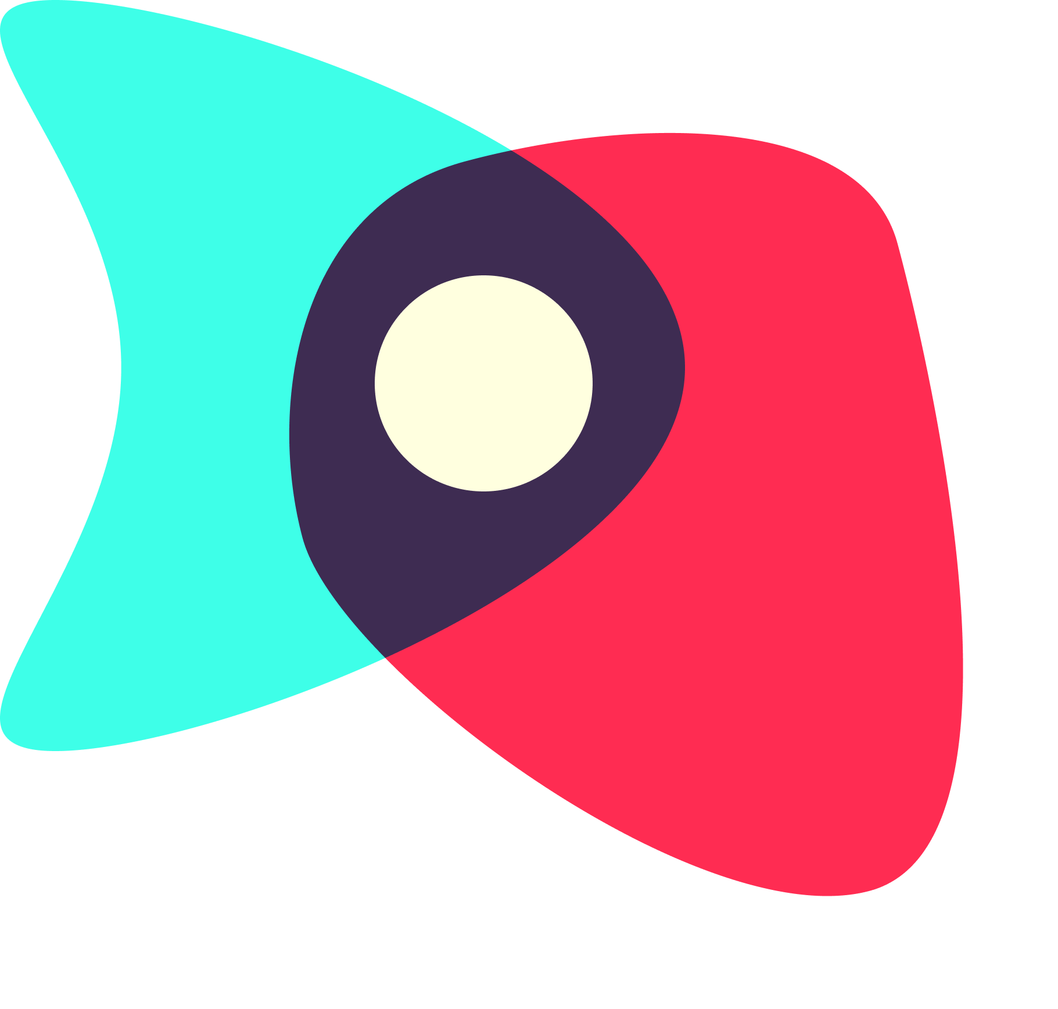
Digital Democracy:
Low-fi Prototype &
Pilot Usability
Sharewaves
Garrick F. | Gen S. | Grace W.
Notes:
New title slide

Slide 2

→
Team Intro
Problem/Solution Overview
Selected Interface
Low-Fi Prototype
3 Task Flows
Experiment
Method
Results
UI Changes + Summary

Slide 3
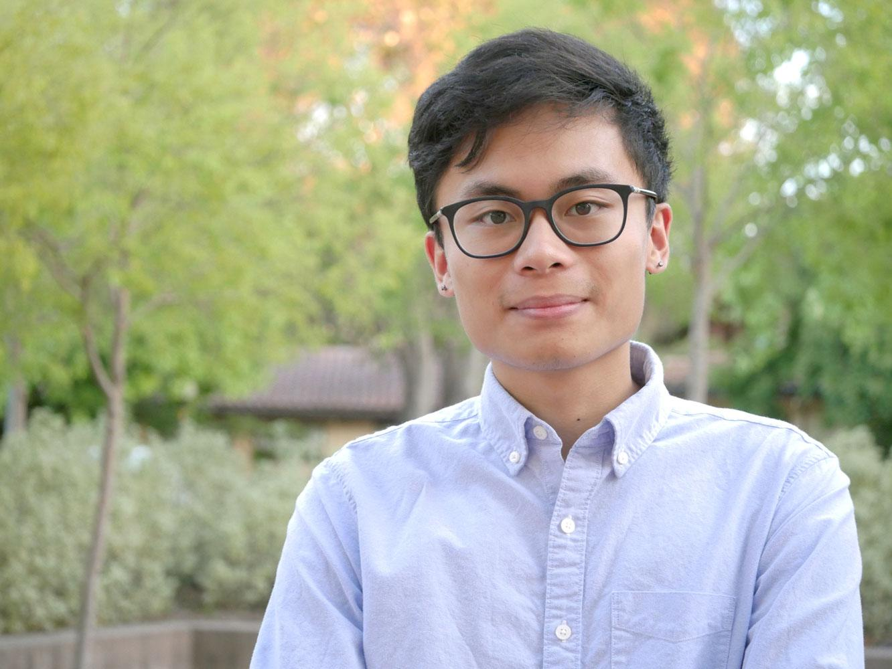
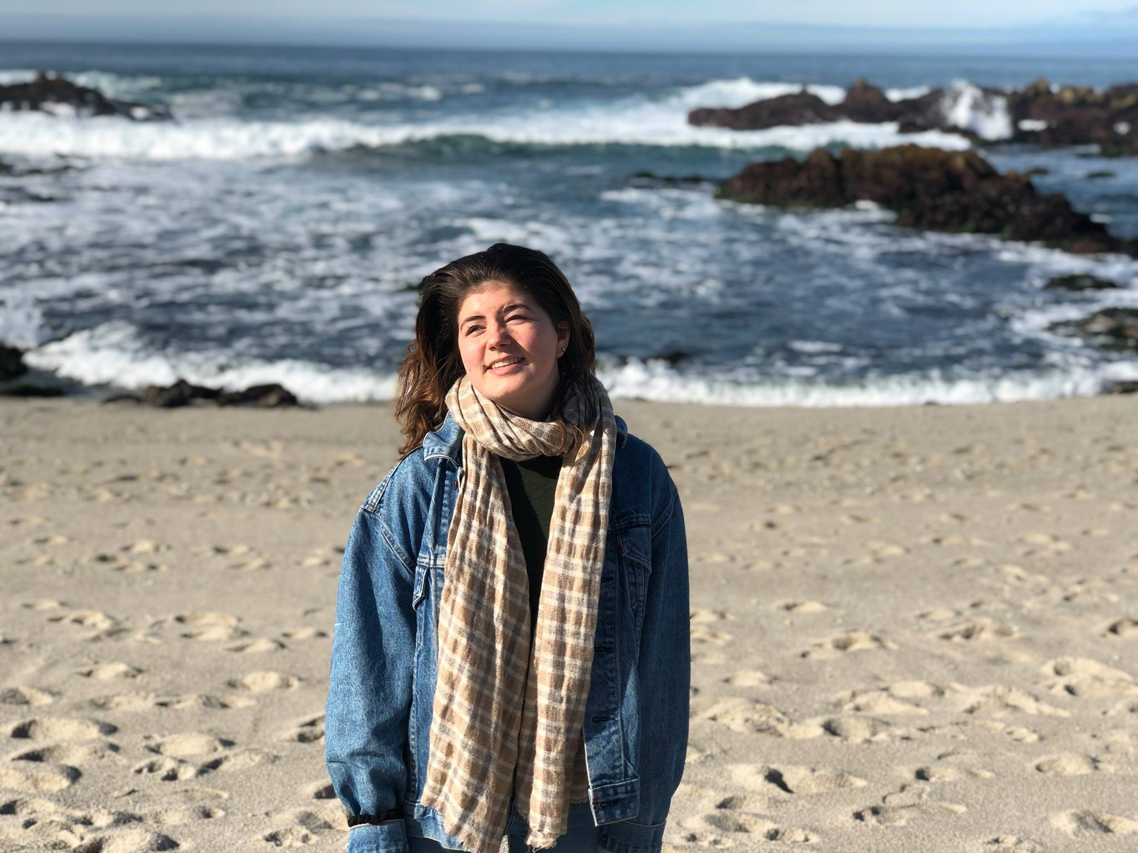
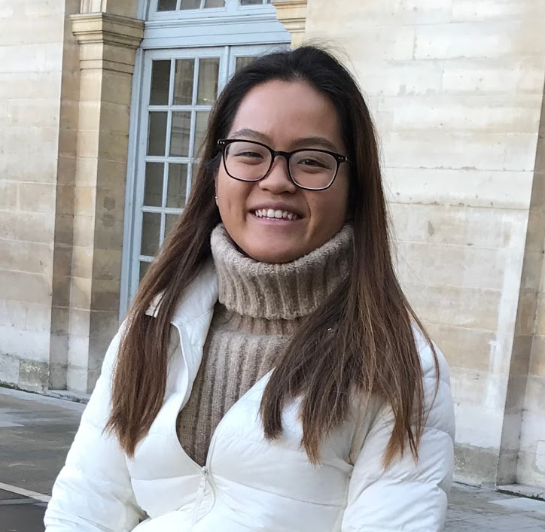
Garrick
Gen
Grace
Coterm, CompSci
no records, doesn’t plank
Senior, SymSys
middle school basketball MVP
Senior, Econ
guinness world record for most people planking
Our mission is to help people harness the activation energy from reading and sharing news into getting involved with political issues in their own communities.
Notes:
Introduce team and mission

Slide 4

The Problem
Online communities, discourse, and news divide and isolate people, leaving them feeling hopeless, unenergized, and without clear ways to participate in politics.
Notes:
Introduce problem (There are already ways people read and share news out there, but in our needfinding and EP testing we saw people who were unenergized and feeling hopeless. When you read the news a common feeling you get is “what can I do about it”)

Slide 5

The Solution
We provide a platform for people to rally around stories they care about, see people like them, and get offline—sparking political conversation and action in their communities.
Notes:
Introduce solution (We are the thing you can do about it. idea is to get offline!!!)

Slide 6

Notes:
Here’s our name and value proposition. With our app, you can see the changes happening in your communities and contribute to it, and it’s just an extra no-frills layer on top of the news-reading experience.

Slide 7
→
Team Intro
Problem/Solution Overview
Selected Interface
Low-Fi Prototype
3 Task Flows
Experiment
Method
Results
UI Changes + Summary

Slide 8
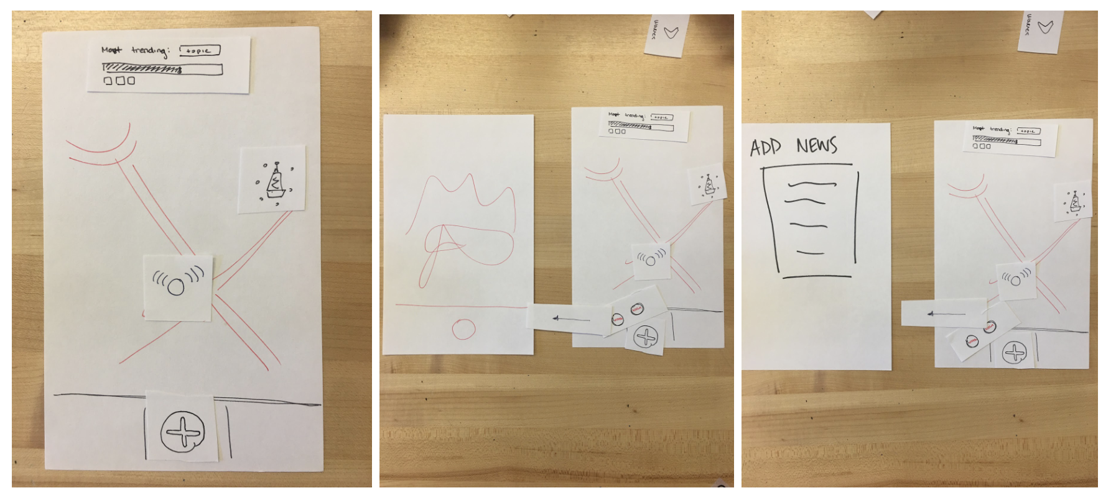
Design Interface: Geographic Map Interface

Slide 9
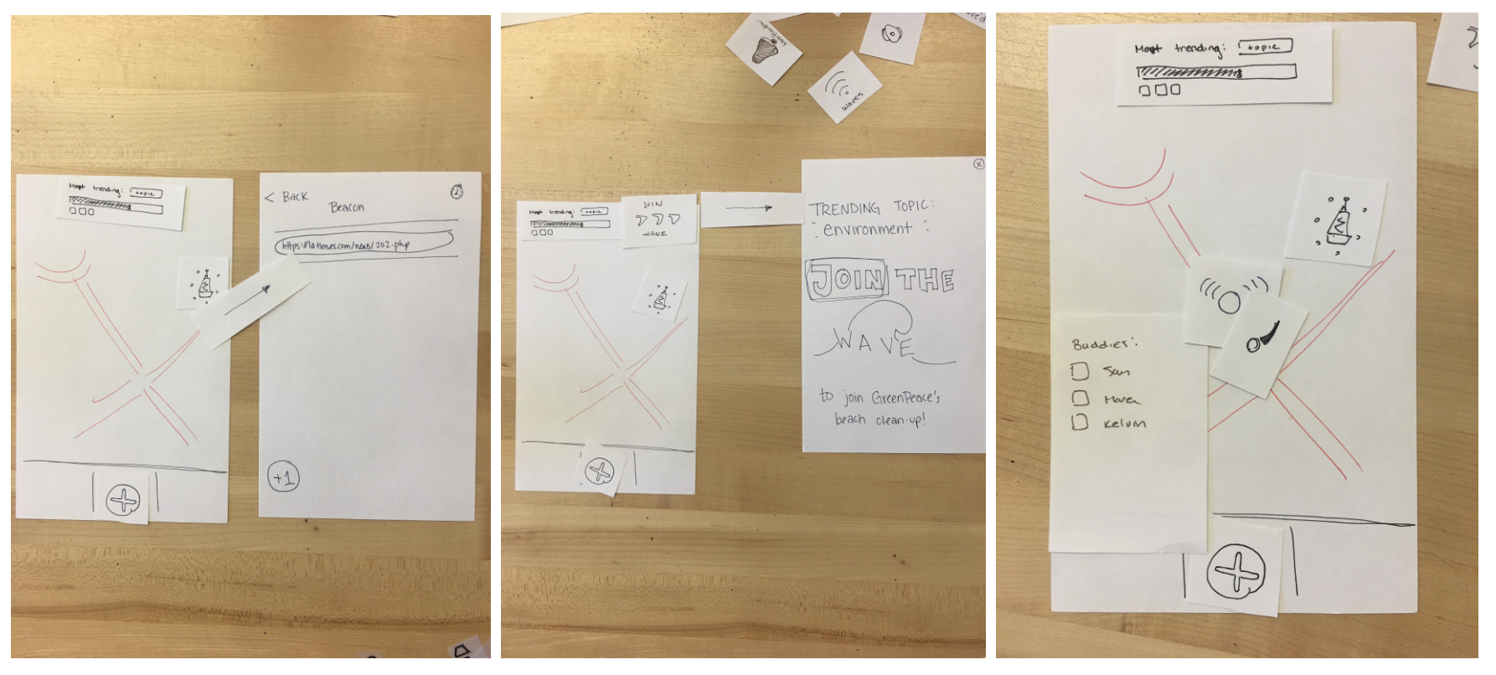
Design Interface: Geographic Map Interface

Slide 10
Design Interface: Rationale
Pros
Human element is apparent
Lends itself to organization
Video element: could integrate other technologies with the Map
Broadcasting feature would allow for passive claims of politics without confrontation
Cons
Complicated (overwhelmed by potential tasks): want to be as lightweight experience on top of news as possible
Geographical closeness could reinforce echo chamber

Slide 11
→
Team Intro
Problem/Solution Overview
Selected Interface
Low-Fi Prototype
3 Task Flows
Experiment
Method
Results
UI Changes + Summary

Slide 12
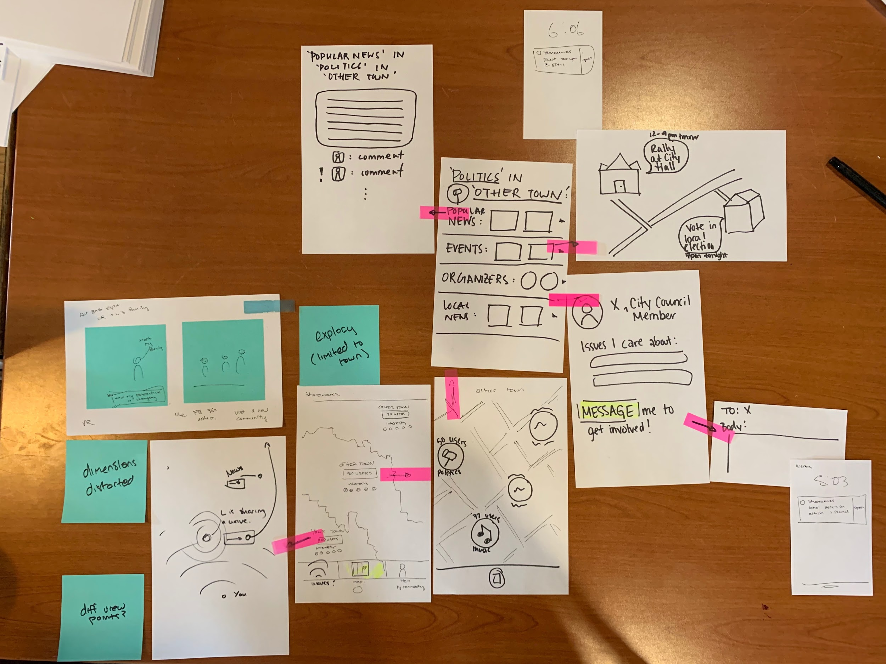
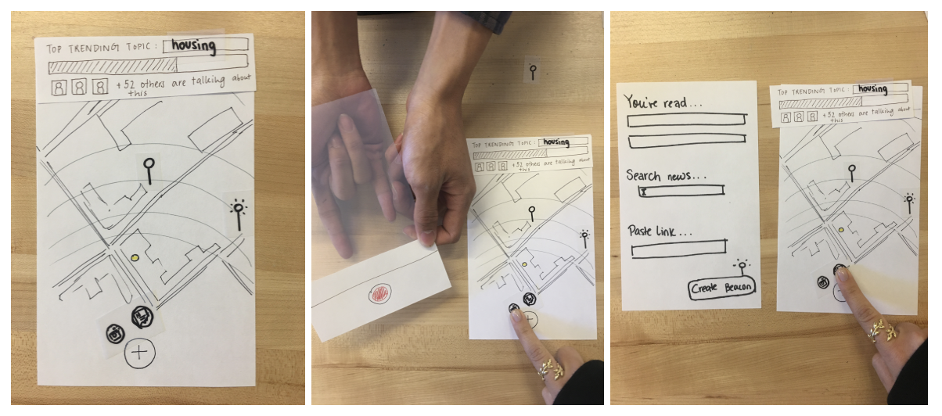
Reduce to core functionality
Notes:
When we were working on the low-fi, one of the things we sought from the detailed task flow was to remove extraneous experiences (DM’s, feeds, profiles, forms, etc.) that didn’t serve our reworded problem/solution and tasks.

Slide 13
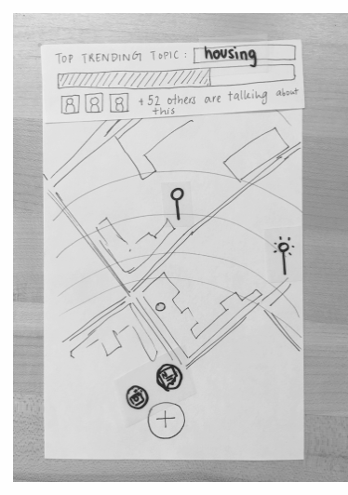
Spark offline activity:
pressure meter
buddies
Explore stories:
beacons
activity
you
Share stories:
news
video
Notes:
Explain UI elements, whittling down to core functions

Slide 14
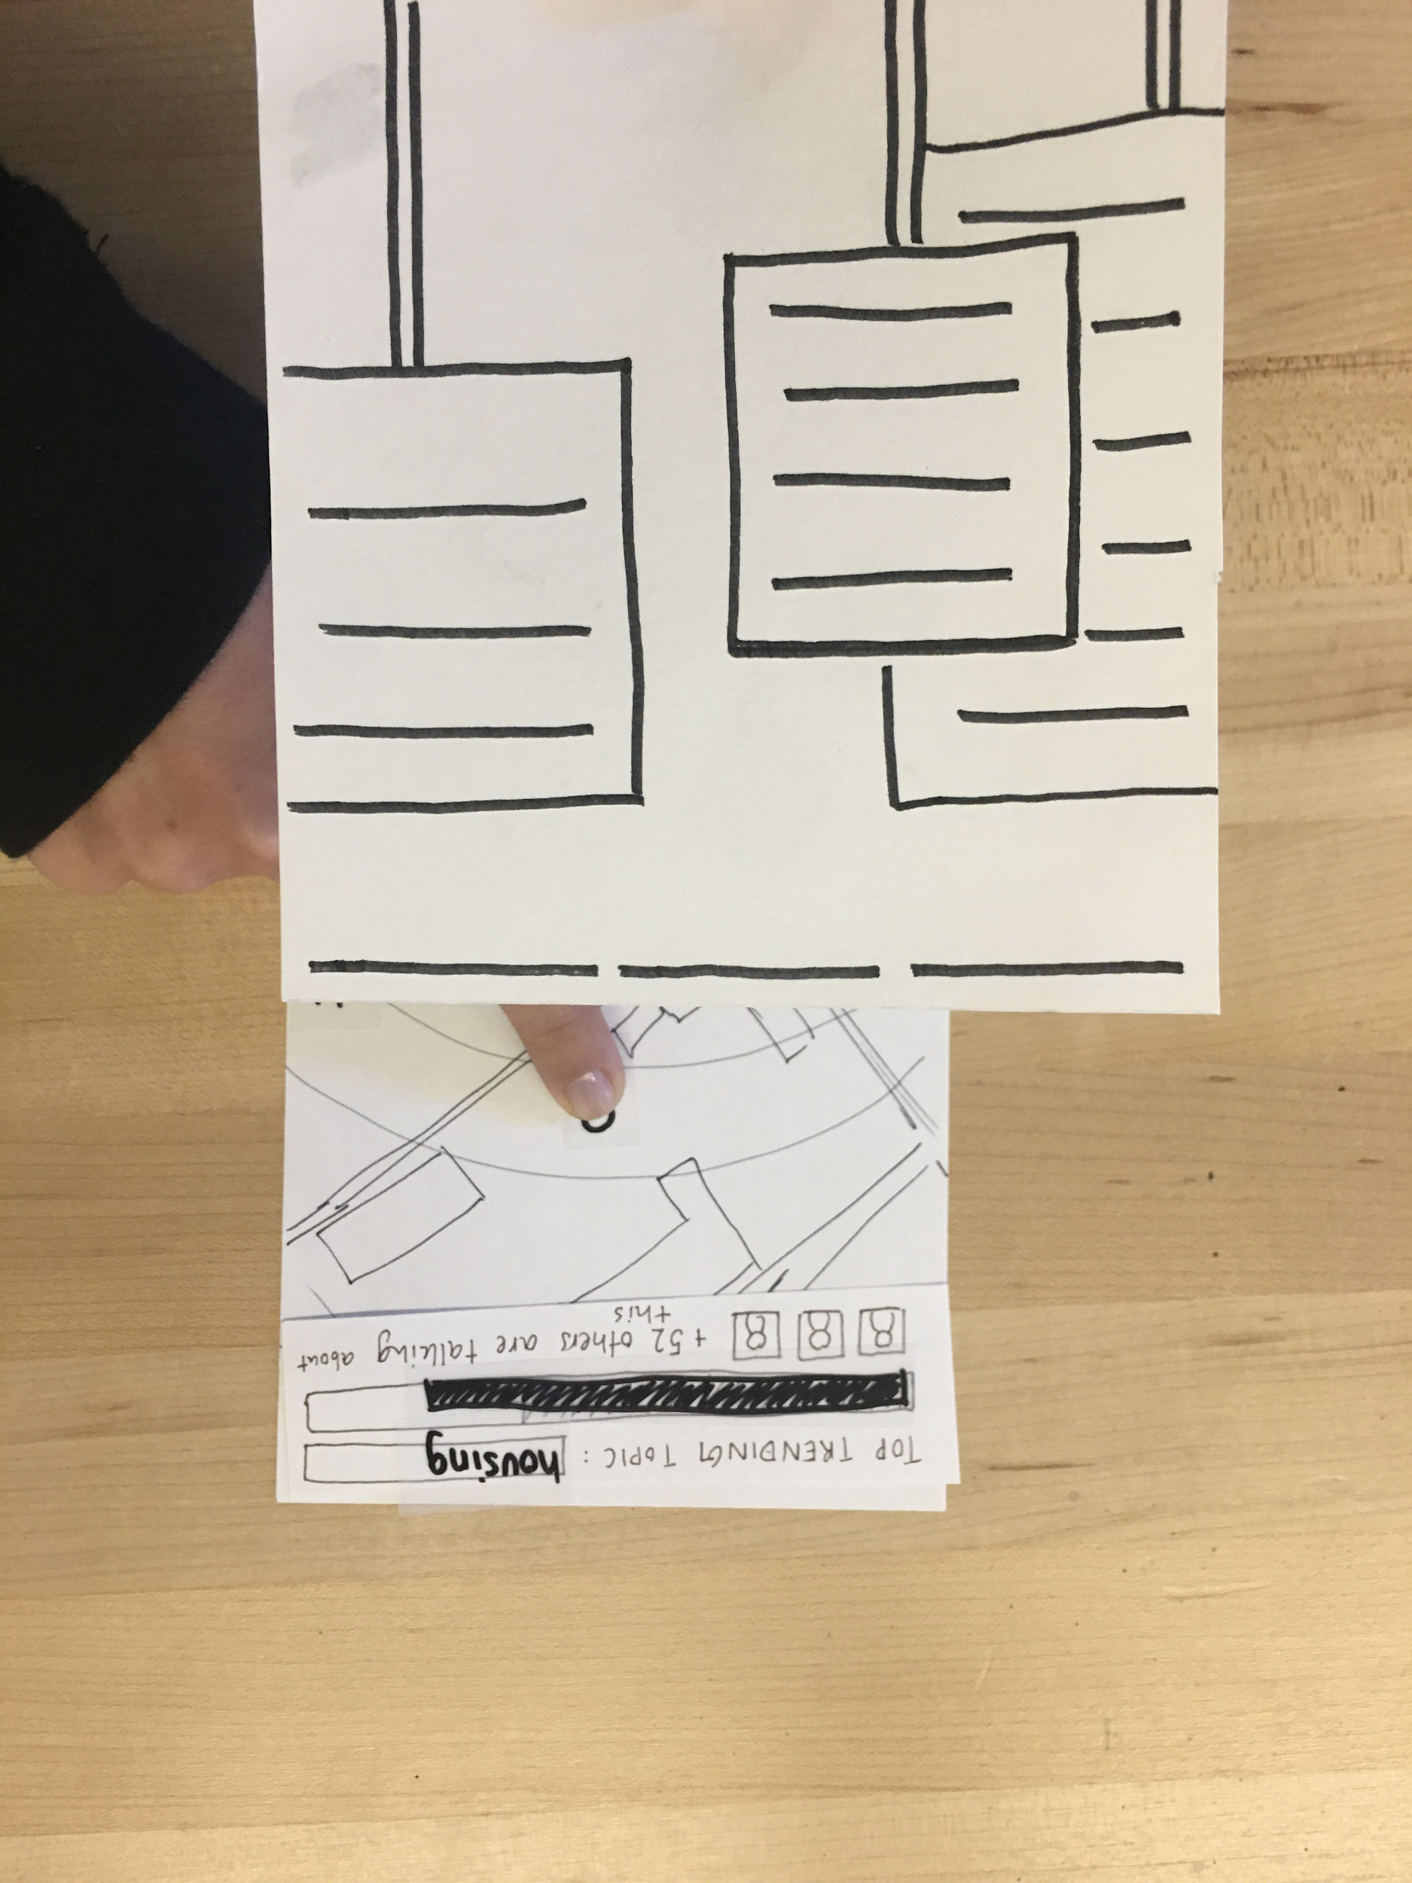
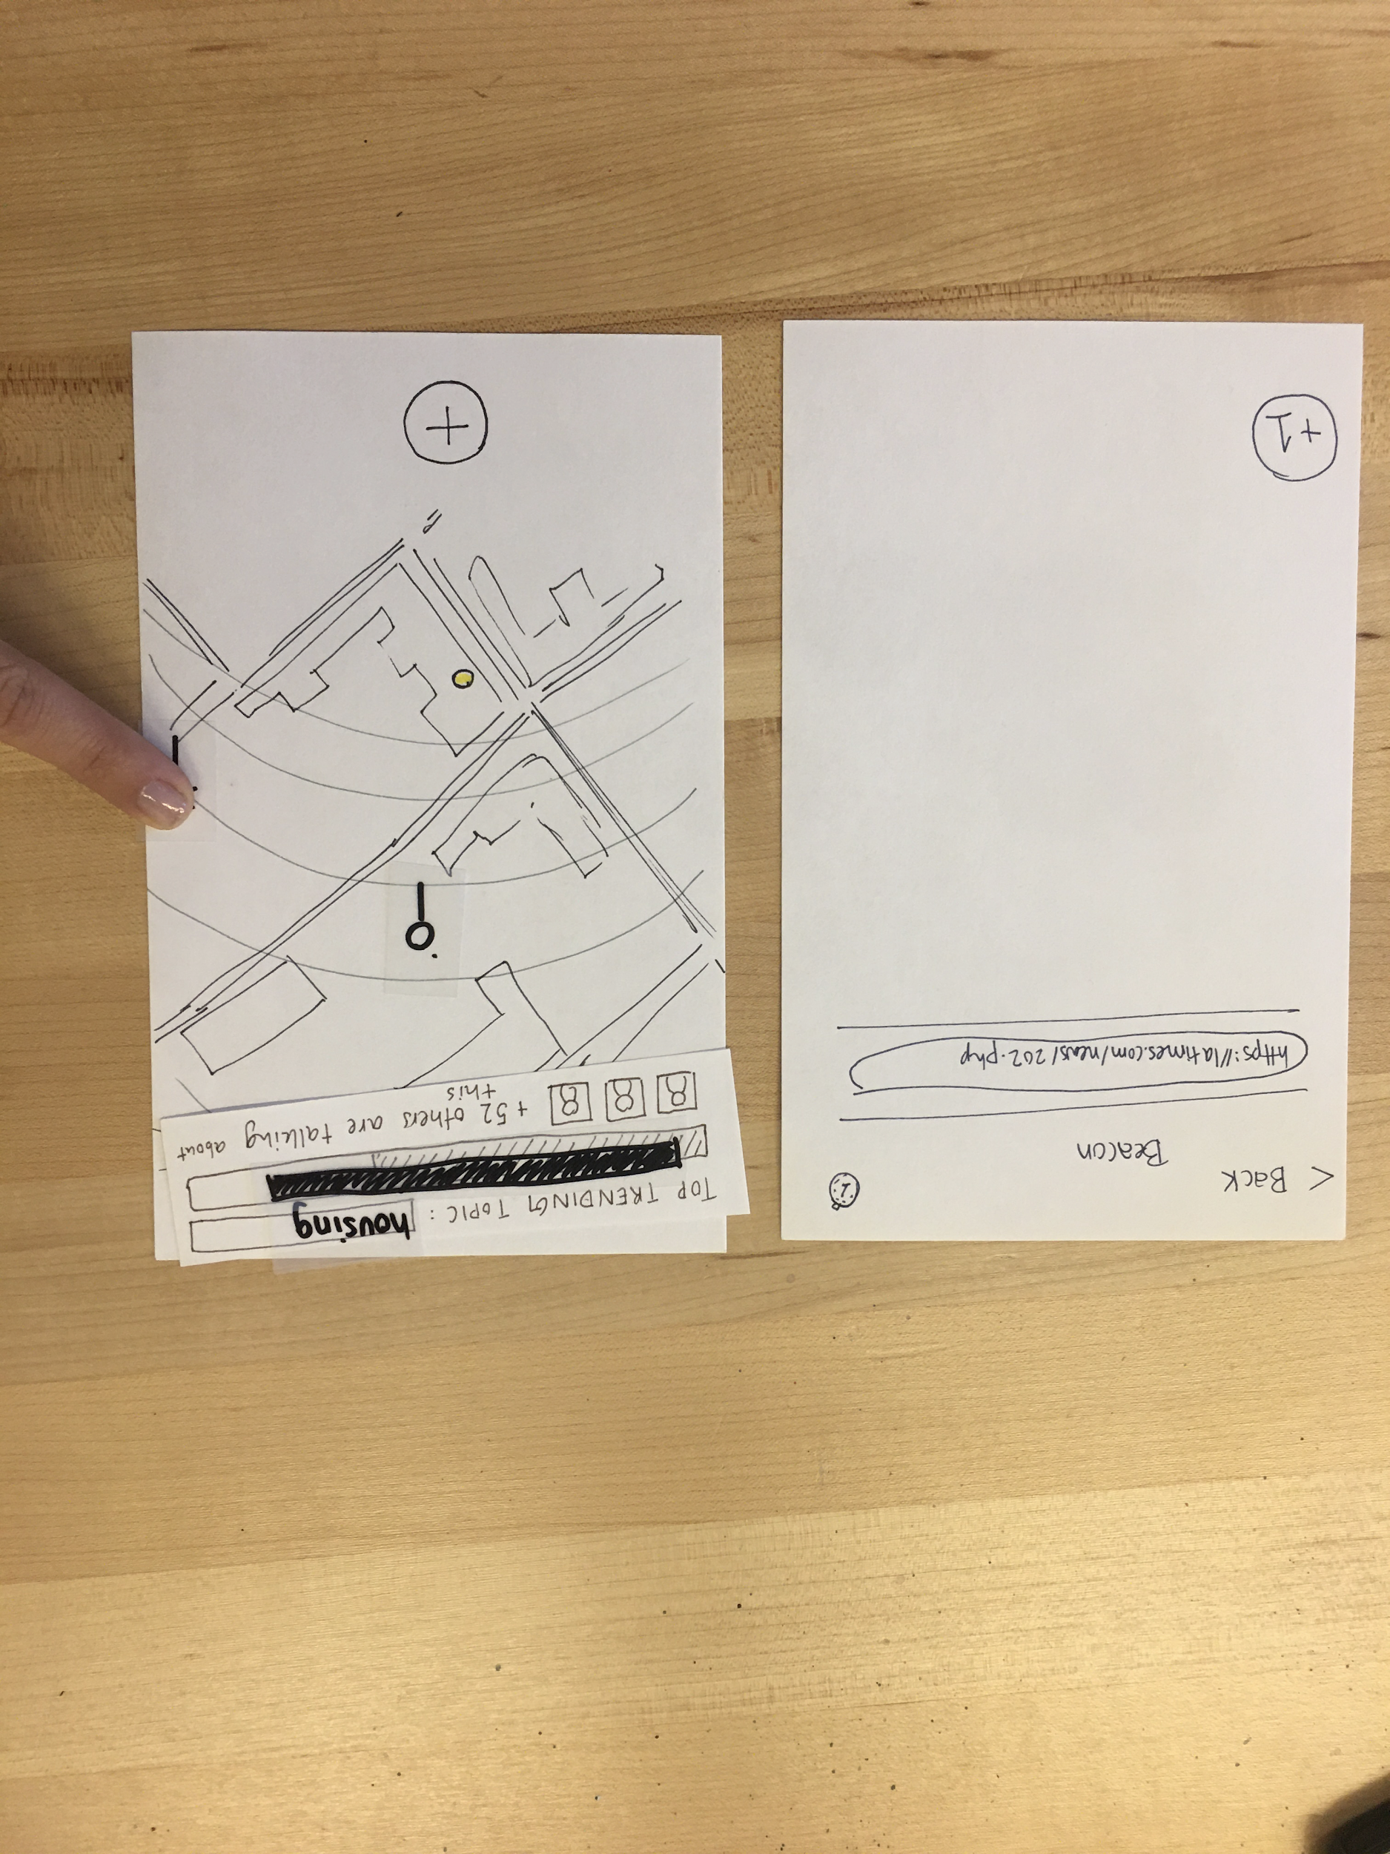
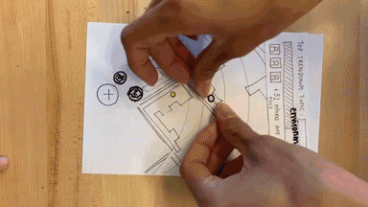
Task #1: discover nearby stories
Notes:
Task flow:
Click on beacon, display videos
Click on beacon, display news

Slide 15
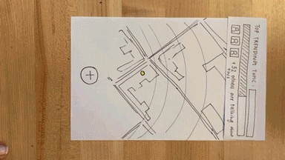
Task #2: share your stories
Notes:
Task flow:
Click on camera to share video
Click on the news button to share news articles

Slide 16
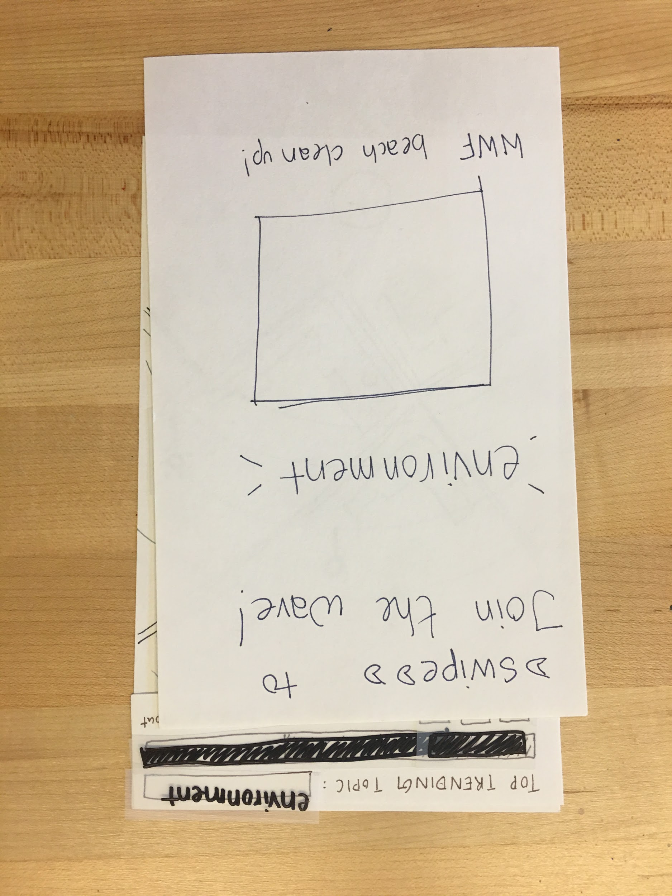
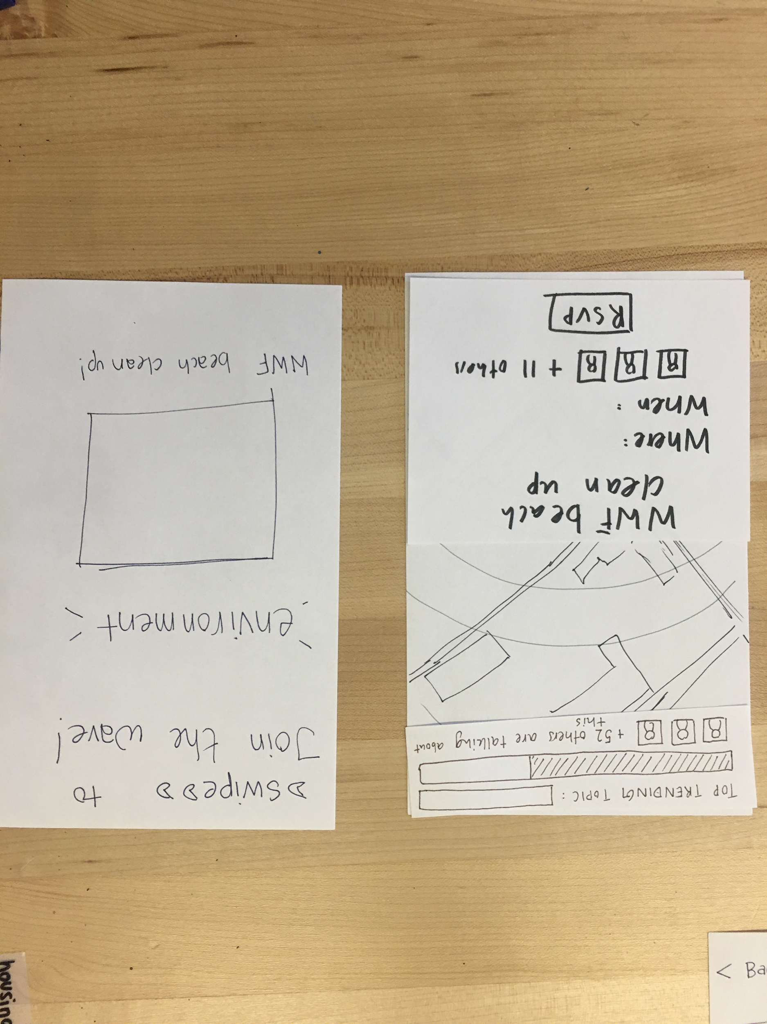
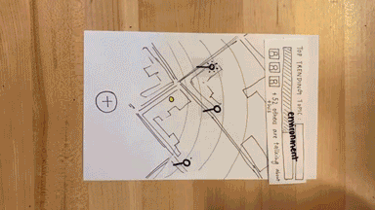
Task #3: spark offline political activity
Notes:
Task flow:
When there is enough interest in a ‘wave’, user can swipe and join events
We can learn more about the event by swiping

Slide 17
→
Team Intro
Problem/Solution Overview
Selected Interface
Low-Fi Prototype
3 Task Flows
Experiment
Method
Results
UI Changes + Summary

Slide 18




Experimental Methodology
Who?
2 M | 2 F
20-23 yr. old
Why?
Target demographic (young, college-educated)
How?
Solicited interviews on low-fi prototype
Where?
Forbes Cafe, Coho, on campus student residence

Slide 19

Experimental Results: Discovery
All three tasks worked
Experiments with discovering tasks, describing components: 5-6 components correctly described, all tasks discovered

Slide 20
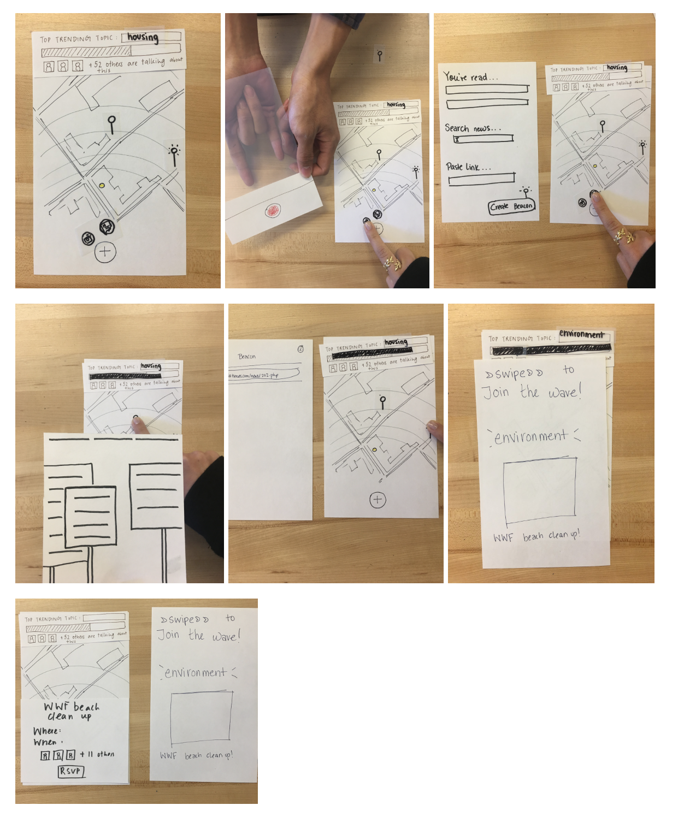
Experimental Results: Errors
People thought the “Join the wave” screen was a pop up ad (take 2 turned out better)
Confusion over the top bar
Clicking on self
Confusion over beacons
dismiss
popup

Slide 21
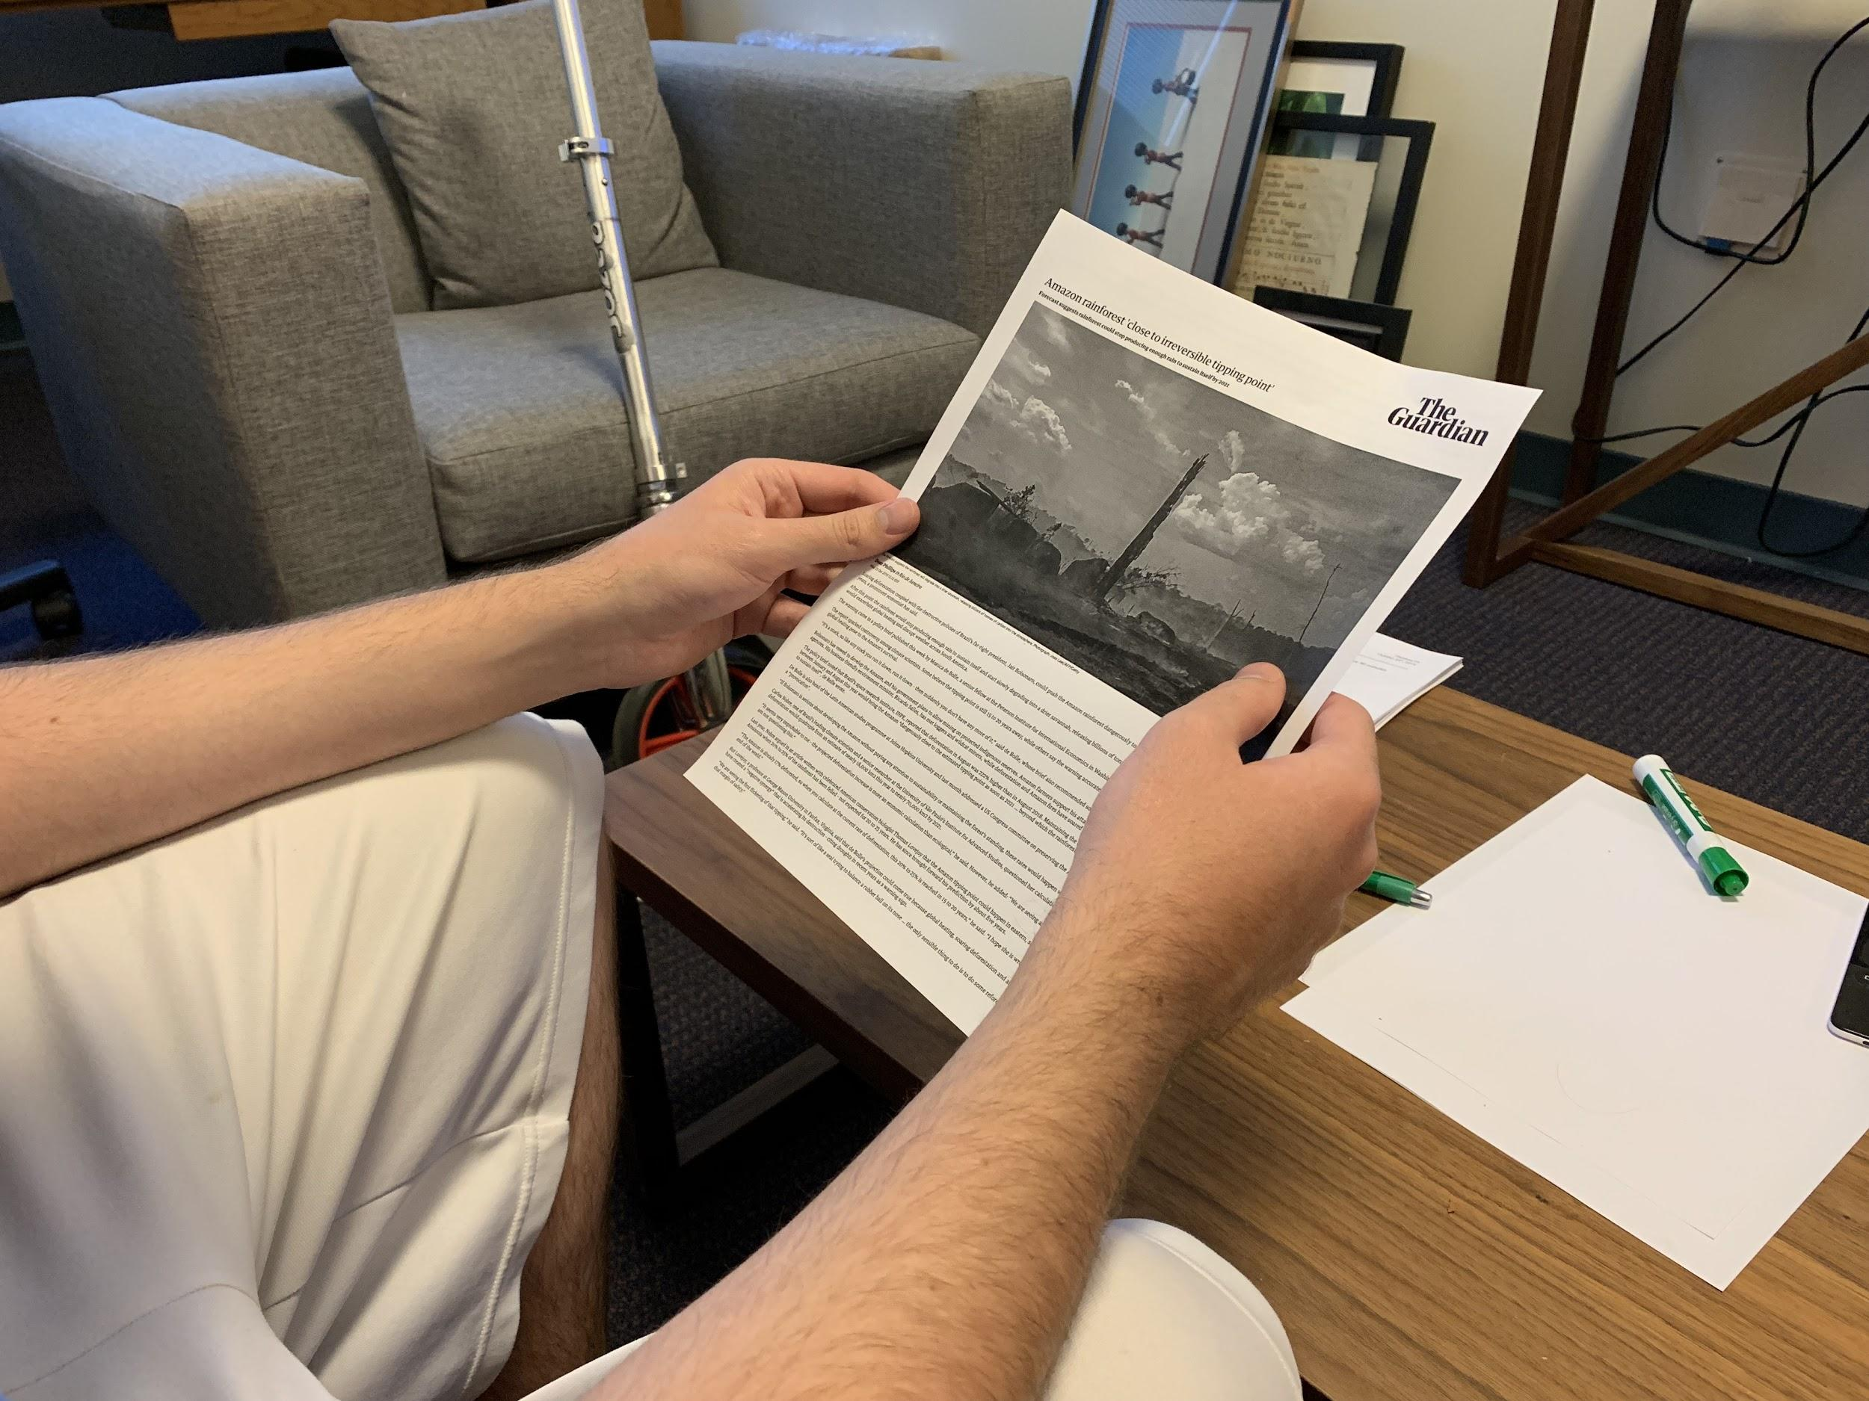
Experimental Results: Successes
Participants seemed to like the app
People wanted to get involved in the events
People understood how the map emphasized community
Notes:
We went back and did another EP to test some assumptions we were making in translating the Map EP and feedback into a low fi prototype. With both the low fi and the pure experience, people were riled up by the news and motivated to do something about it.

Slide 22
Experimental Results: Further Questions
What rewards can you get from participating in events?
“What can I get off the platform that I wouldn’t get normally”
Everyone can use the platform; what happens if it’s for something we don’t like?
Adding in a buddy system?

Slide 23
→
Team Intro
Problem/Solution Overview
Selected Interface
Low-Fi Prototype
3 Task Flows
Experiment
Method
Results
UI Changes + Summary

Slide 24
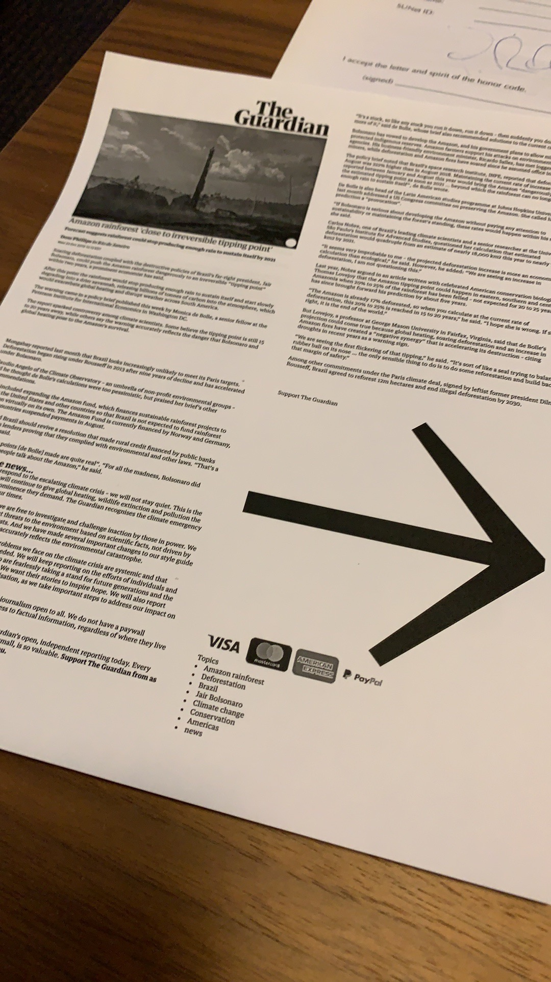
Potential UI Changes
Top bar
Beacon icons
Self-marker
Including actual news

Slide 25
Summary
Where are we now?
Refined problem statement
Refined tasks
Low-fi prototype of core experience
Testing
Where are we going next?
Med-fi: experiment with icons, style, presentation
Solidify theme
Hammer out experience of going to events
Hammer out social/buddy aspect, if any

Slide 26
Thank you!
Any questions?

Slide 27
Appendix: Unused Slides

Slide 28
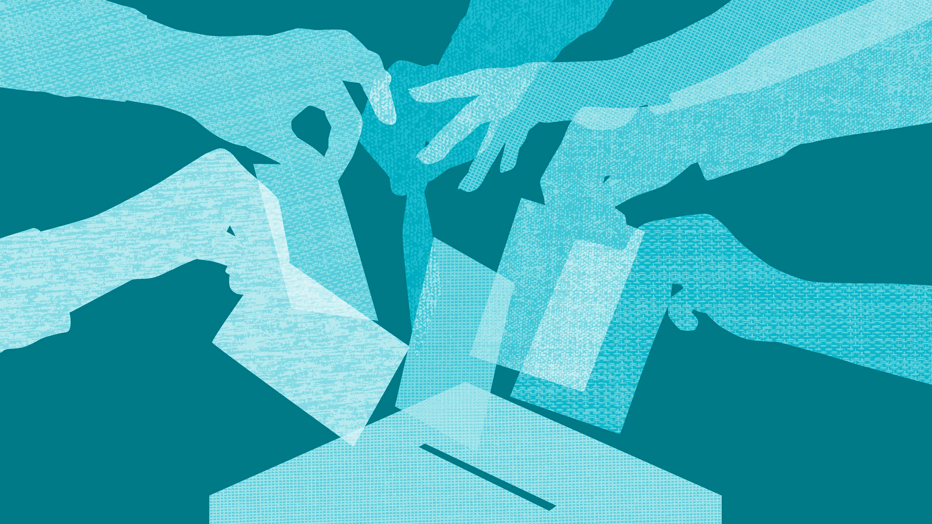
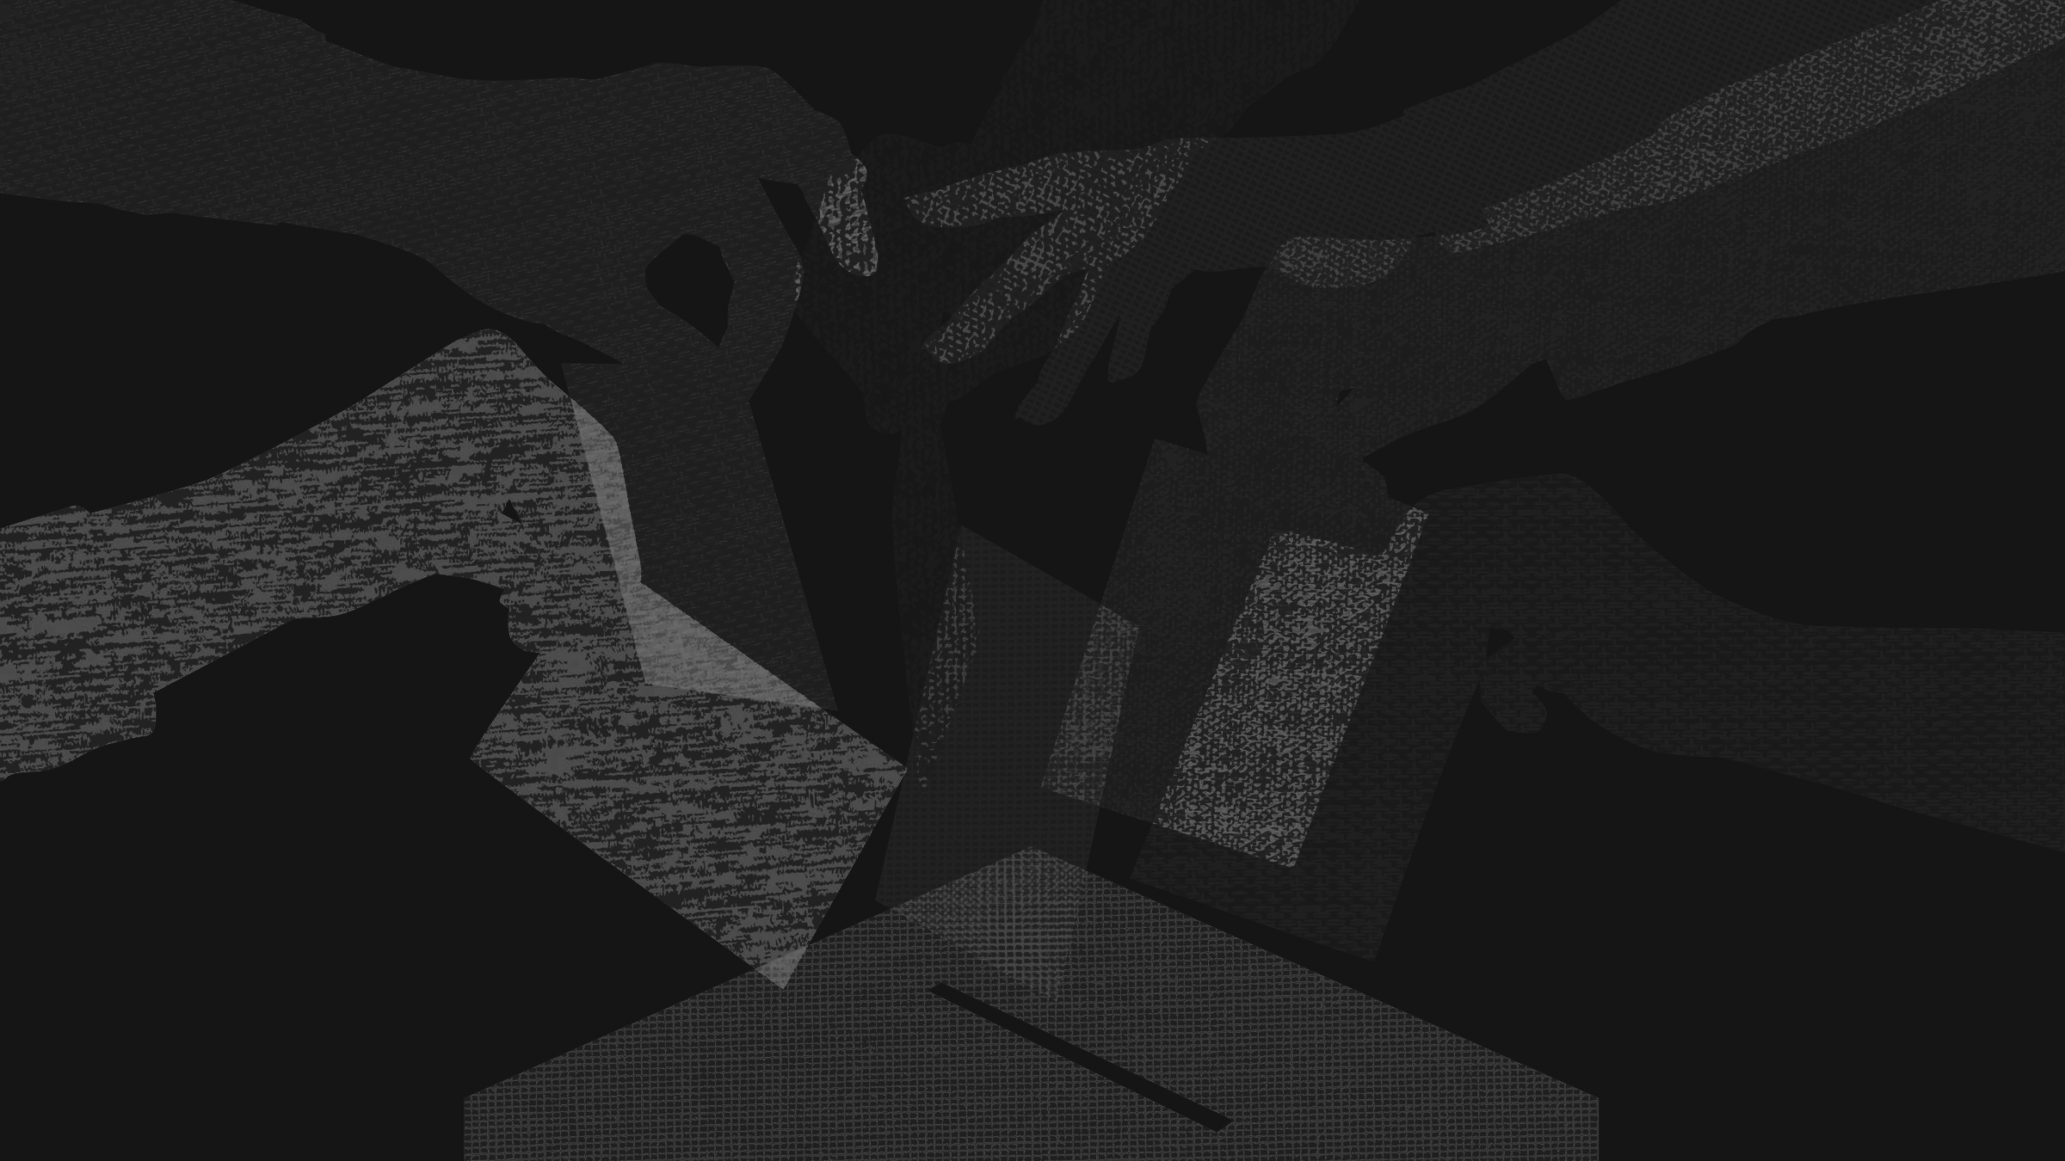
Digital Democracy:
Low-fi Prototype &
Pilot Usability
Sharewaves
Garrick F. | Gen S. | Grace W.
Notes:
We decided it’s time to mix things up...

Slide 29
Experimental Results
(Experiment prototype): Do people want to get involved in events after reading the news and seeing activity?
Proximity to placed beacons instead of people: safety feedback
What sorts of events are good for small communities?
Notes:
We went back and did another EP to test some assumptions we were making in translating the Map EP and feedback into a low fi prototype

Slide 30
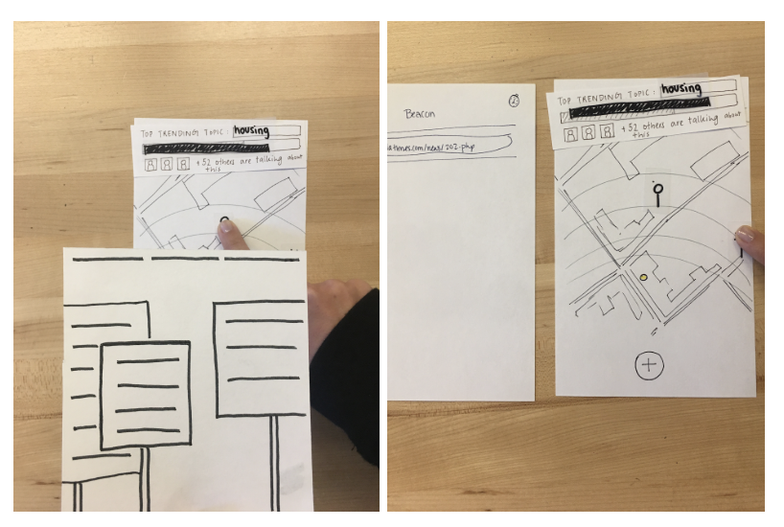
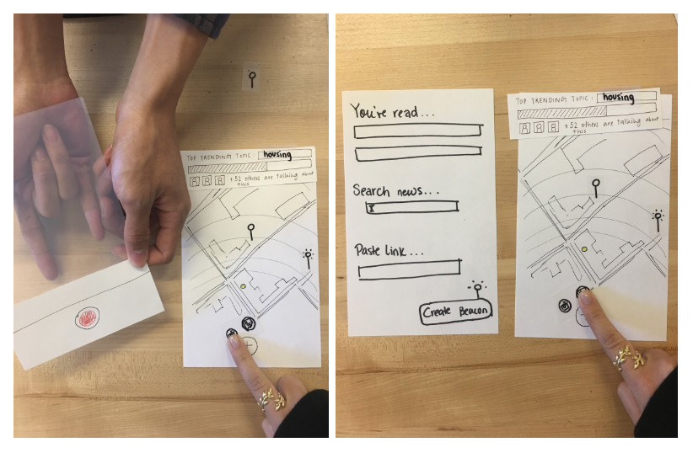
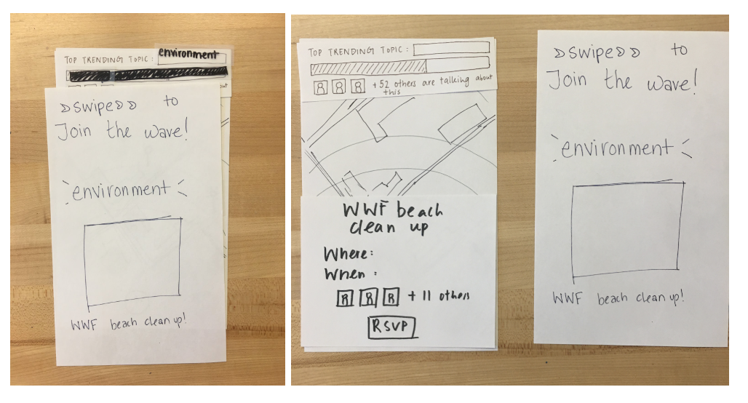
popup
dismiss

Slide 31
Low-fi Prototype Structure

Slide 32
Notes:
more screens and a gif of the interaction

